Slide 1
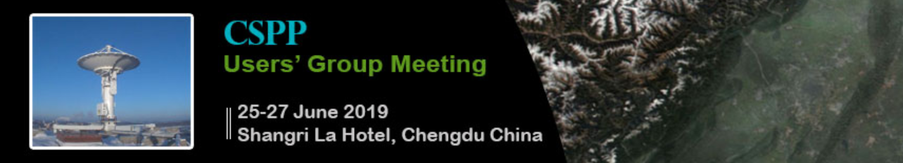


25 Years of operation and applications of the IMAA-CNR direct readout satellite receiving station
Teodosio Lacava, Emanuele Ciancia, Alfredo Falconieri, Mariapia Faruolo, Carolina Filizzola, Nicola Genzano, Mariano Lisi, Francesco Marchese, Giuseppe Mazzeo, Nicola Pergola, Valeria Satriano, Valerio Tramutoli

Slide 2
Outline
Introduction
The Robust Satellite Techniques (RST) approach
RST Applications
Conclusion
CSPP 2019 – 25-27 June 2019, Shangri La Hotel Chengdu China Teodosio Lacava

Slide 3
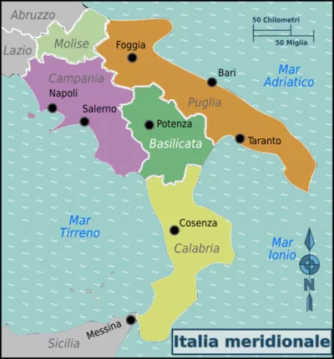
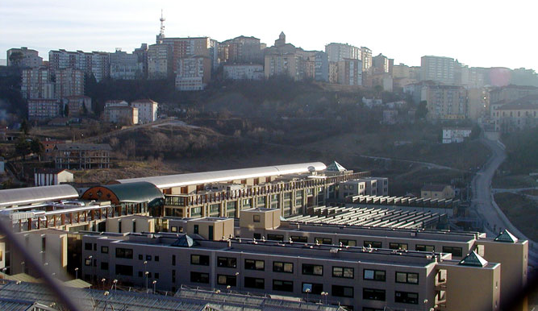
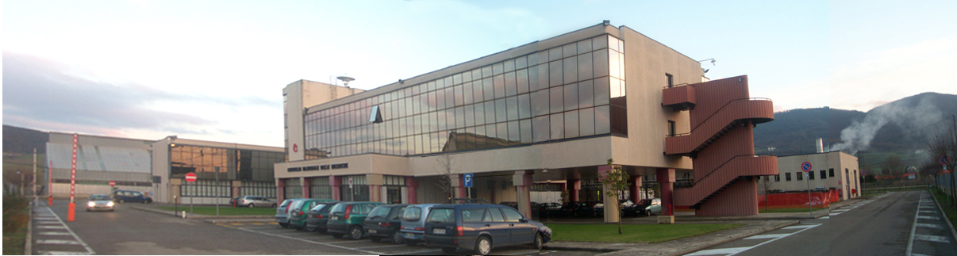
Introduction: Where we are
  University of Basilicata - School of Engineer
  Airborne and Satellite (Satellite Data Analysis Lab)
  National Research Council – Institute of Methodologies for Environmental Analysis
  (Airborne and Satellite Remote Sensing Lab)
CSPP 2019 – 25-27 June 2019, Shangri La Hotel Chengdu China Teodosio Lacava

Slide 4
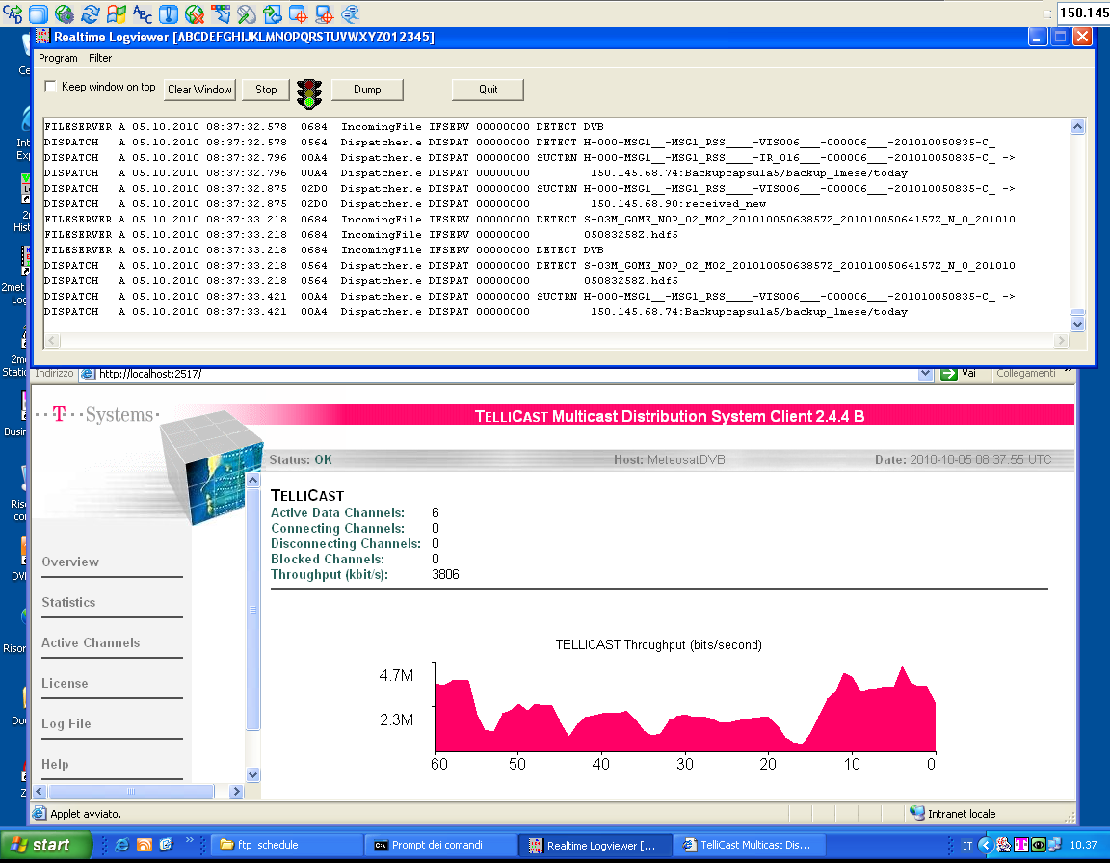
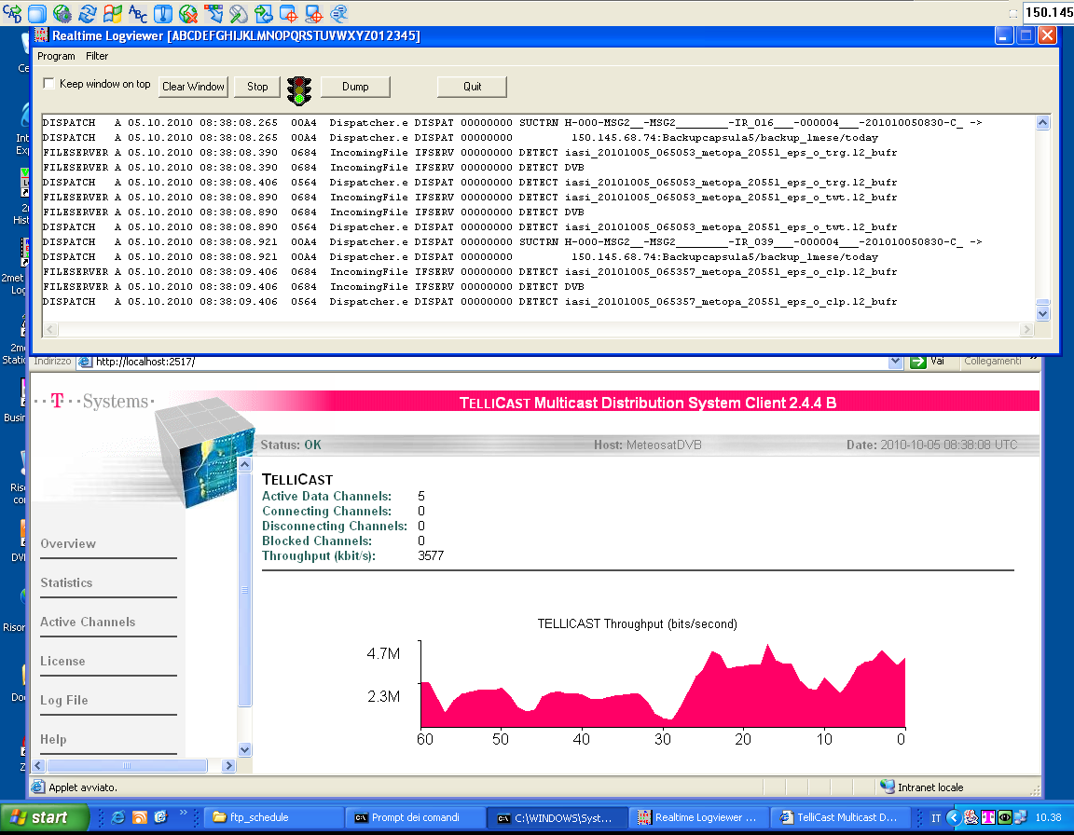
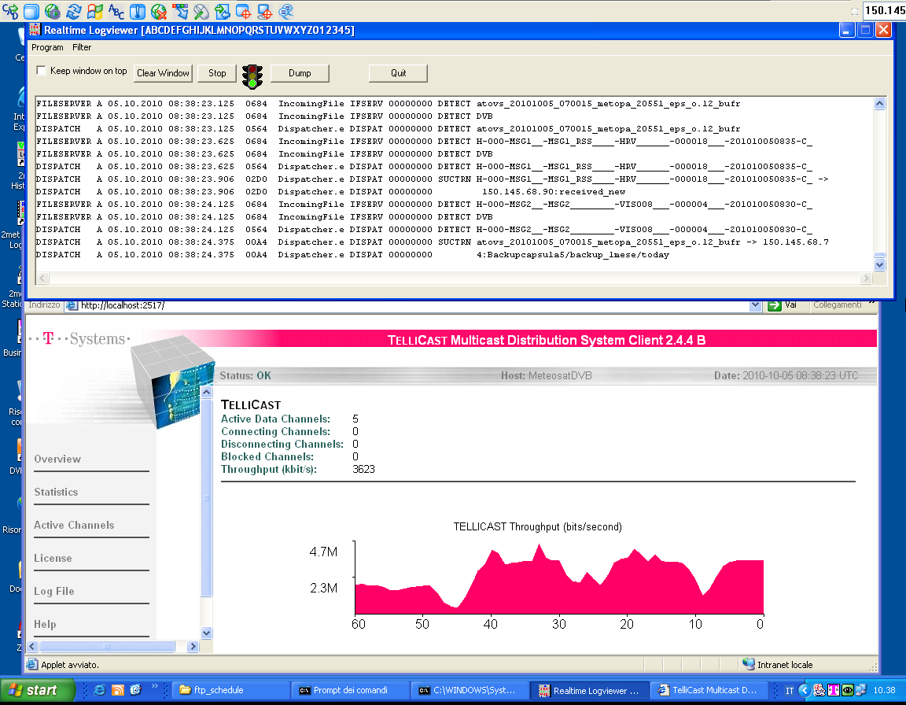
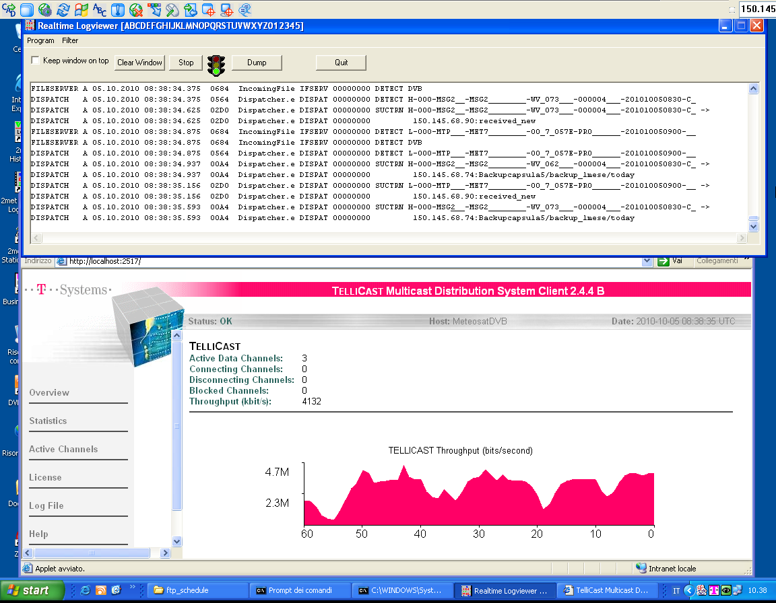

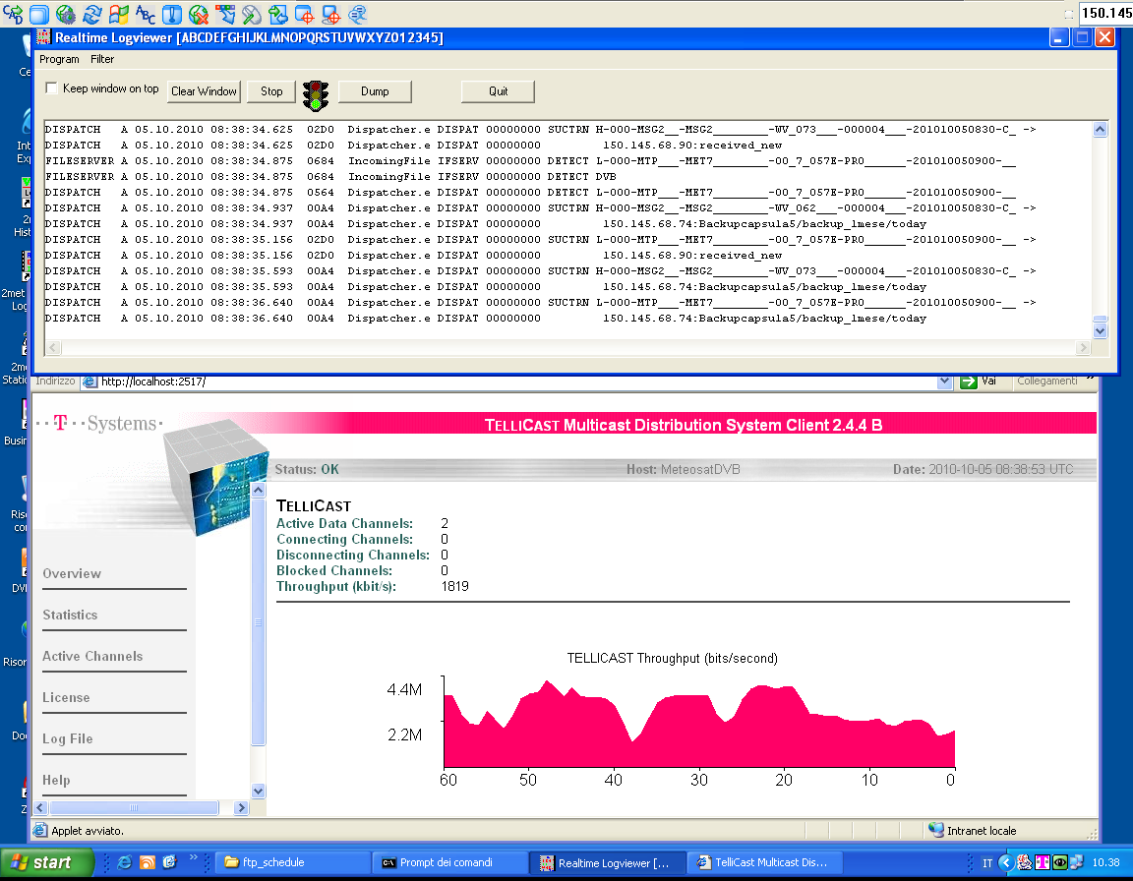
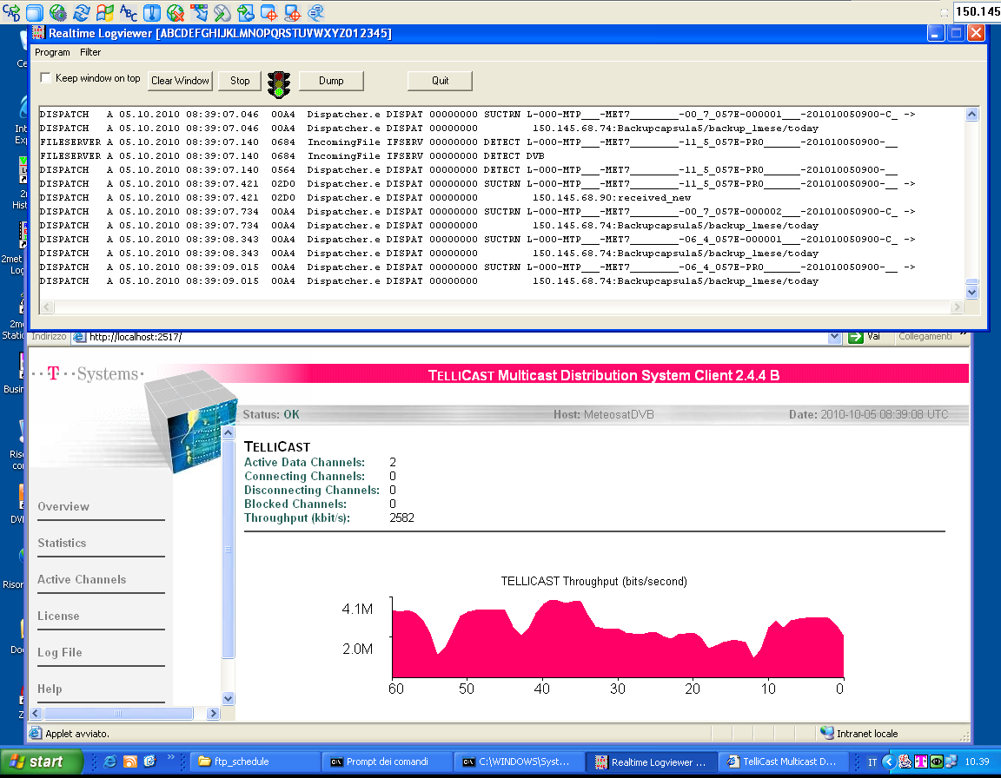
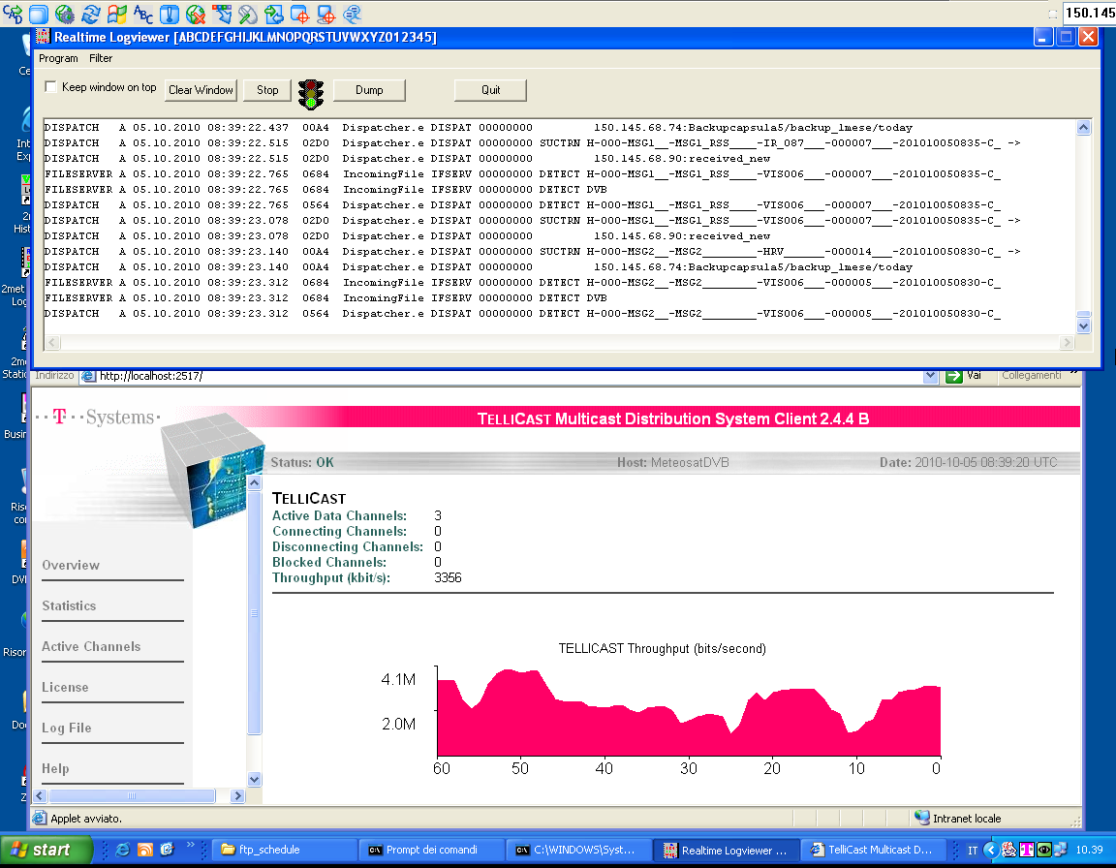

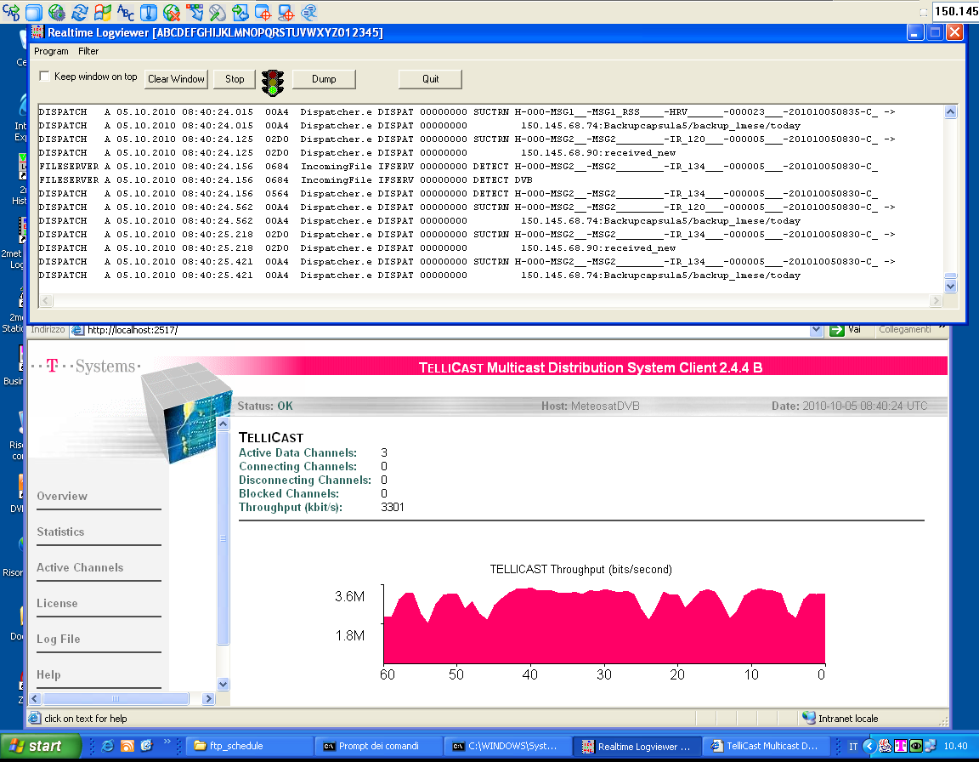
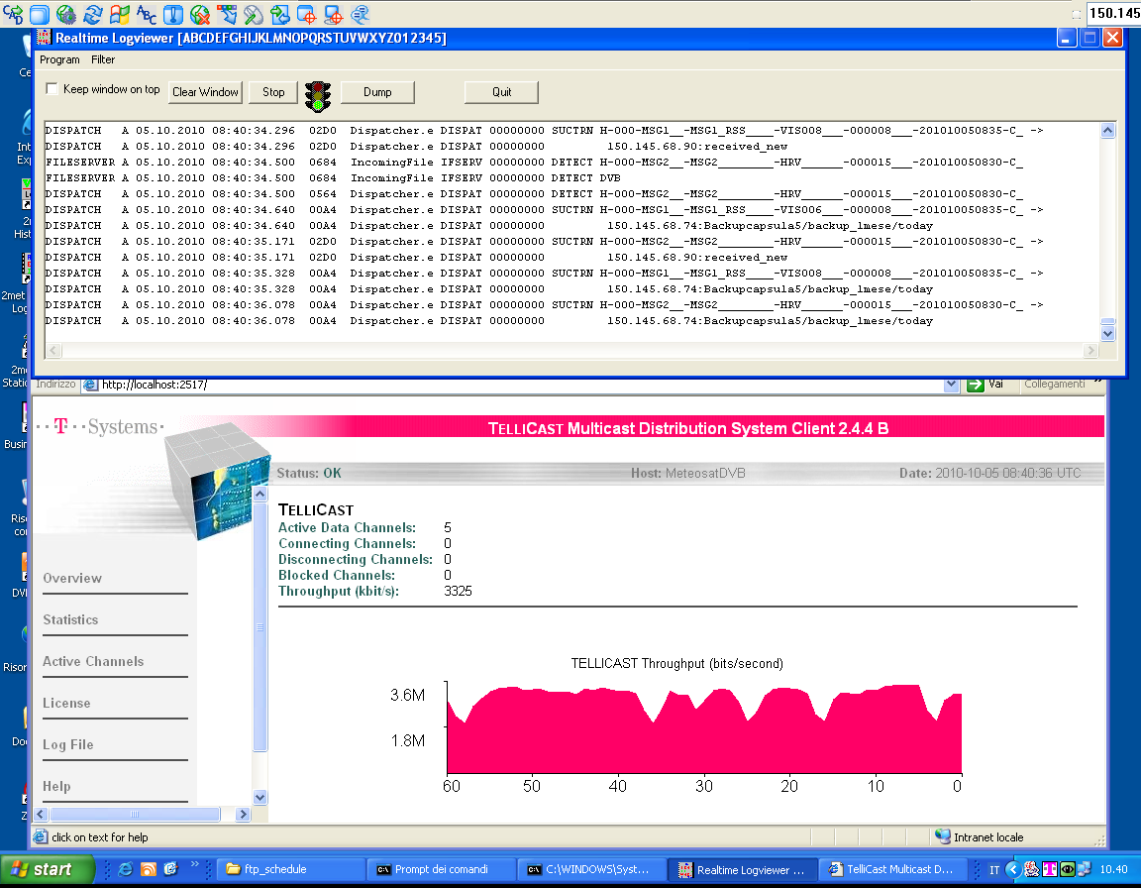
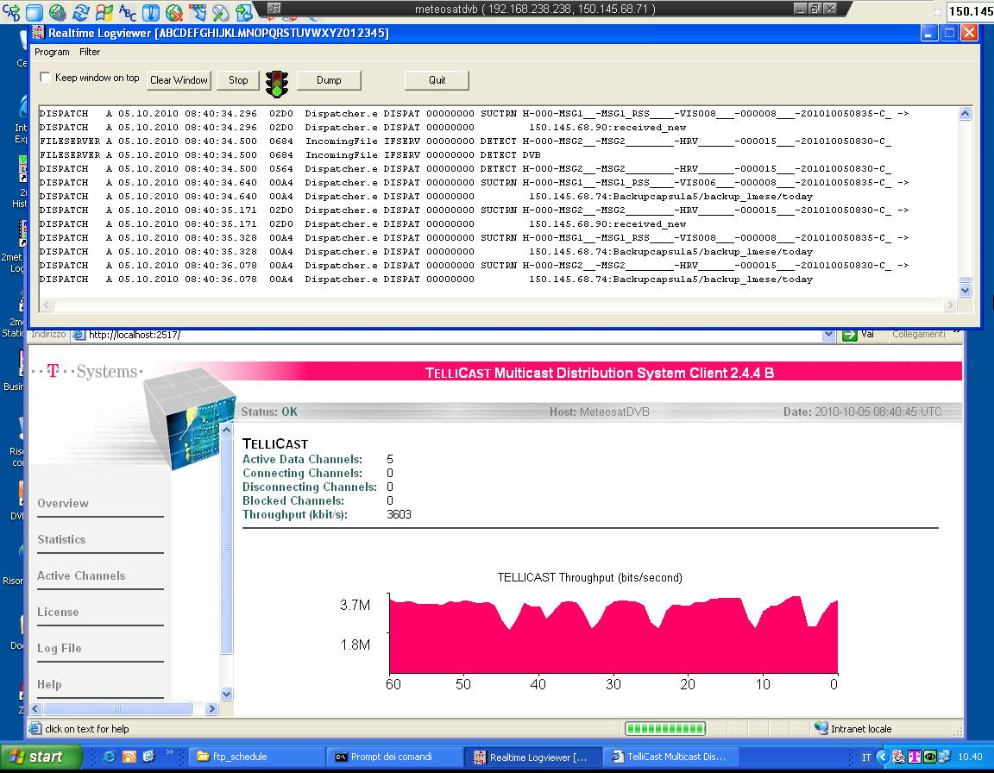
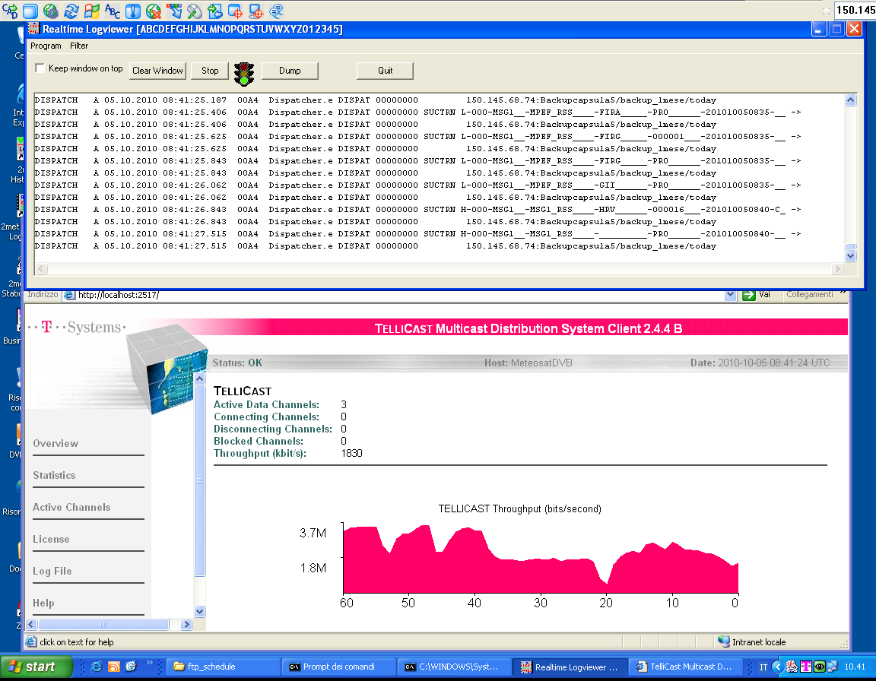
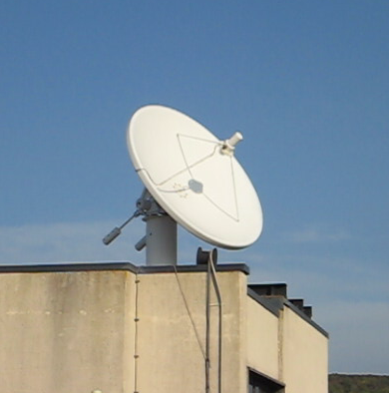
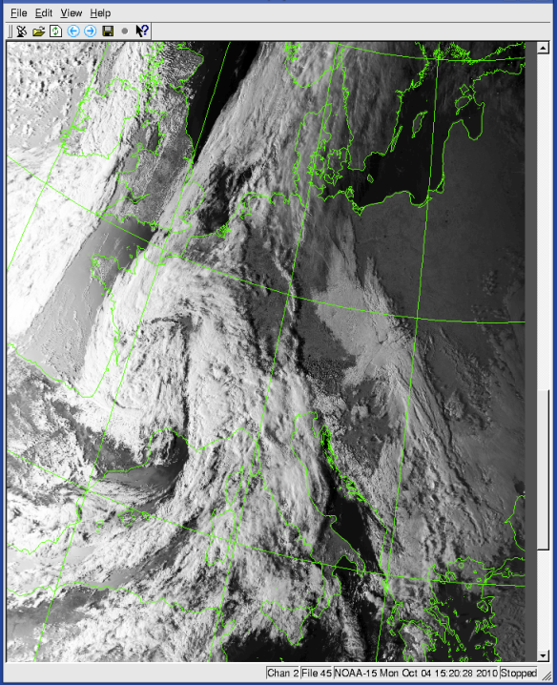
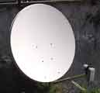

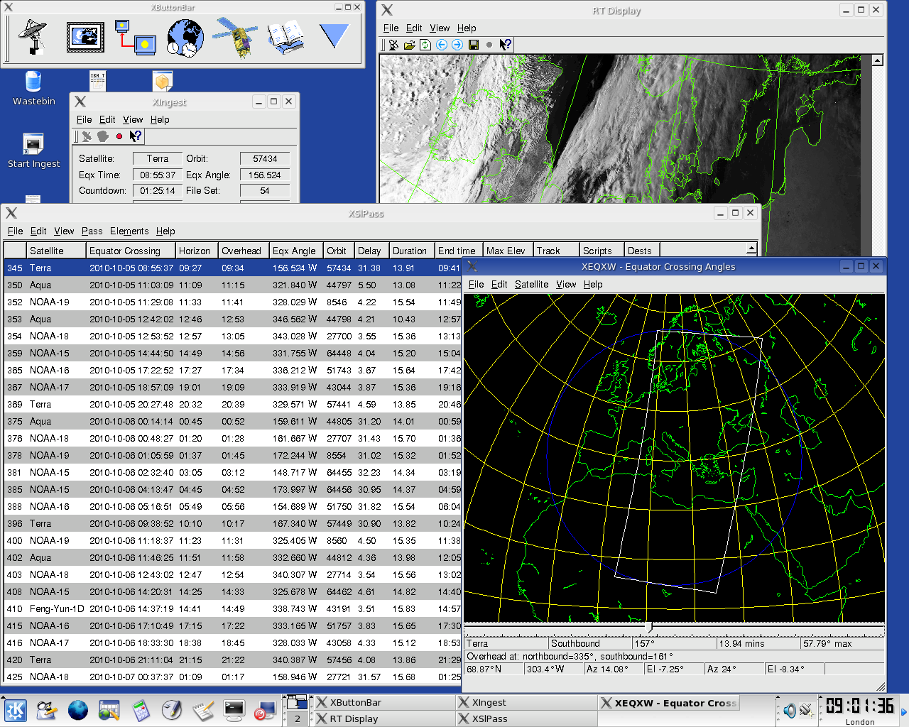
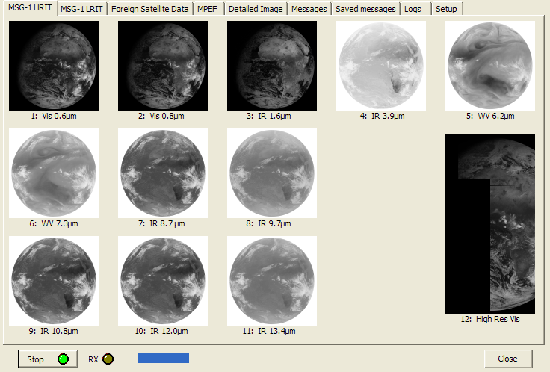

Introduction: Facilities and data
L&X-band receiving station
EUMETCAST System
CSPP 2019 – 25-27 June 2019, Shangri La Hotel Chengdu China Teodosio Lacava

Slide 5
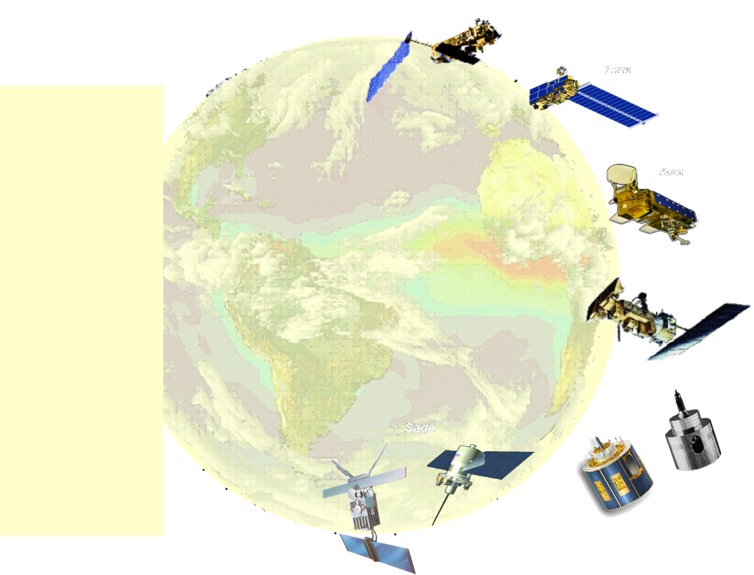
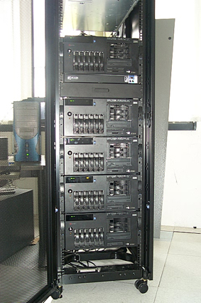
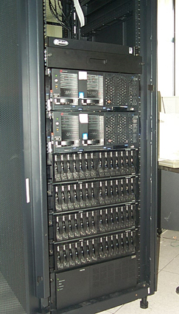

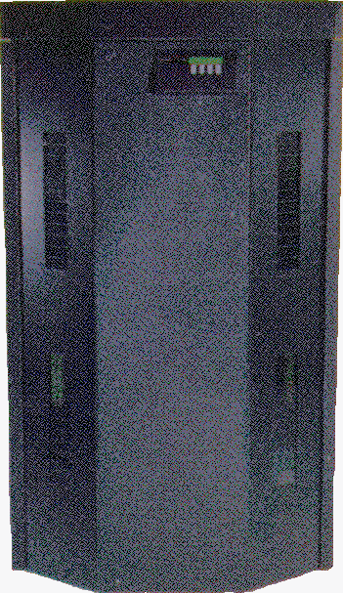
Introduction: Facilities and data
  EOS – Terra&Aqua
  NOAA-POES
  Meteosat
  MSG
  METOP-A&B&C
  SNPP&JPSS
  Foreign (GOES, MTSAT, etc)
  Other (Landsat, Sentinel)
Present storage capacity ~ 200 Terabytes (170 TB on Line)
Web
Web
Direct acquisition
Historical Archive
Web access
CSPP 2019 – 25-27 June 2019, Shangri La Hotel Chengdu China Teodosio Lacava

Slide 6
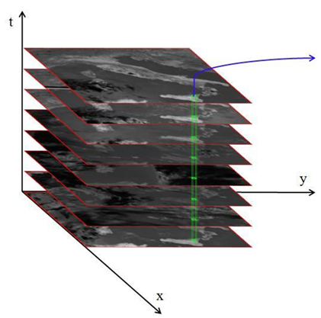
The Robust Satellite Techniques (RST) approach
What does anomaly mean?
anomalies ?
Signal V at pixel (x,y)
Max threshold
Min threshold
time
Fixed threshold approach
CSPP 2019 – 25-27 June 2019, Shangri La Hotel Chengdu China Teodosio Lacava

Slide 7
The Robust Satellite Techniques (RST) approach
What does anomaly mean?
anomalies ?
Signal
false alarms increased
low
threshold
Max threshold
Min threshold
time or space
anomalies ?
Signal
sensitivity reduced
Max threshold
high
threshold
Min threshold
time or space
Fixed threshold approach
CSPP 2019 – 25-27 June 2019, Shangri La Hotel Chengdu China Teodosio Lacava

Slide 8

The Robust Satellite Techniques (RST) approach
What does anomaly mean in the RST approach (Tramutoli 1998, 2005, 2007)?
V (x, y, t)
V_{REF} (x, y)
V_{REF} ± nσ (x, y)
Signal
anomalies ?
time or space
“Site” effects
Seasonal effects
“False Alarms”
$$⊗_{V(x,yt)}=\frac{V\left(x,y,t\right)−V_{REF}(x,y)}{σ_{V}(x,y)}$$
Reduction of:
CSPP 2019 – 25-27 June 2019, Shangri La Hotel Chengdu China Teodosio Lacava

Slide 9
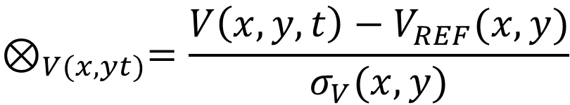
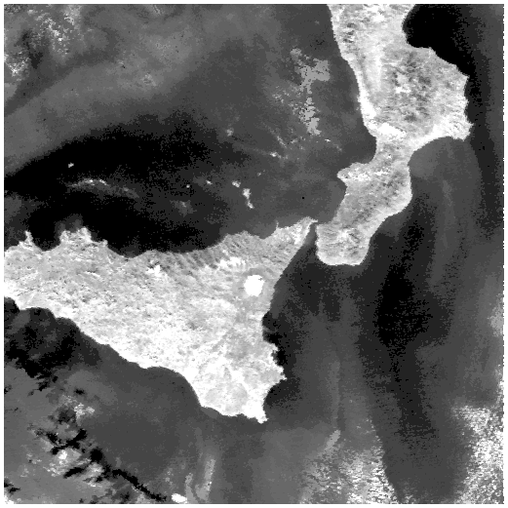
The Robust Satellite Techniques (RST) approach
Computation in the space-time domain of the ALICE (Absolutely Local Index of the Change of the Environment) local variation index as:
$$⊗_{V(x,yt)}=\frac{V\left(x,y,t\right)−V_{REF}(x,y)}{σ_{V}(x,y)}$$
y
1. Construction of historical data-sets of satellite images V_{i}(x,y,t), according to homogeneous criteria (same channels, same month and hour of acquisition)
2. Computation of the background “Reference Fields” of temporal mean, V_{REF} (x,y) and standard deviation σ_{V} (x,y)
x
.
.
3. Change Detection step
t
CSPP 2019 – 25-27 June 2019, Shangri La Hotel Chengdu China Teodosio Lacava

Slide 10
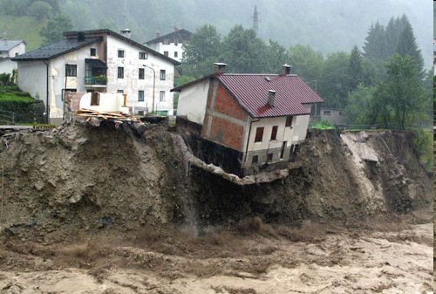
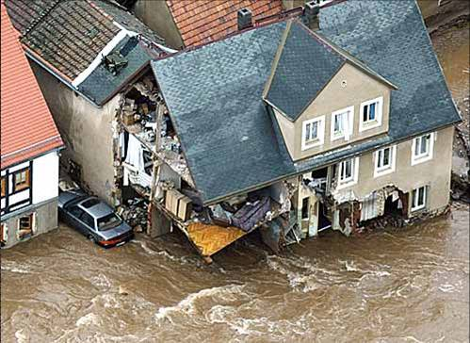
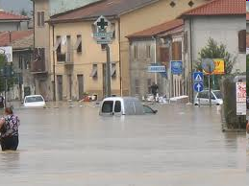
RST APPLICATIONS
Hydrological risk
CSPP 2019 – 25-27 June 2019, Shangri La Hotel Chengdu China Teodosio Lacava

Slide 11
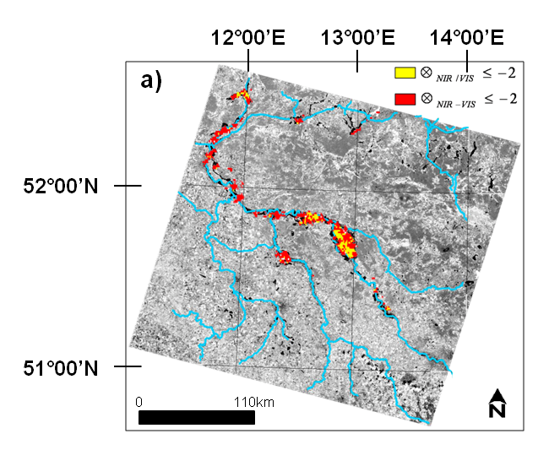
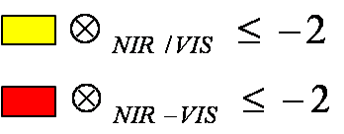
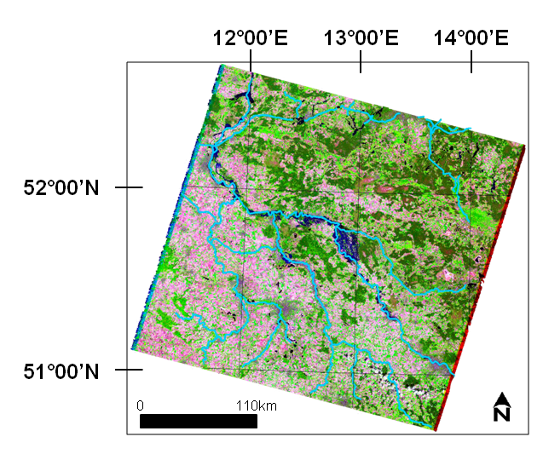
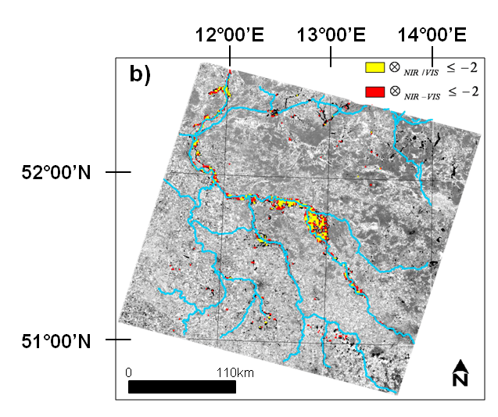
RST Application: Flood - Optical band
V(x,y,t) is a combination of the signals
acquired in the VNIR region (RST-FLOOD)
AVHRR (NIR-RED or NIR/RED)
MODIS (idem)
AVHRR
20 /08/2002
10.49GMT
20 August 2002, 10.00GMT
MODIS
20/08/ 2002
12.00GMT
RGB (543) LANDSAT-7 ETM
CSPP 2019 – 25-27 June 2019, Shangri La Hotel Chengdu China Teodosio Lacava

Slide 12
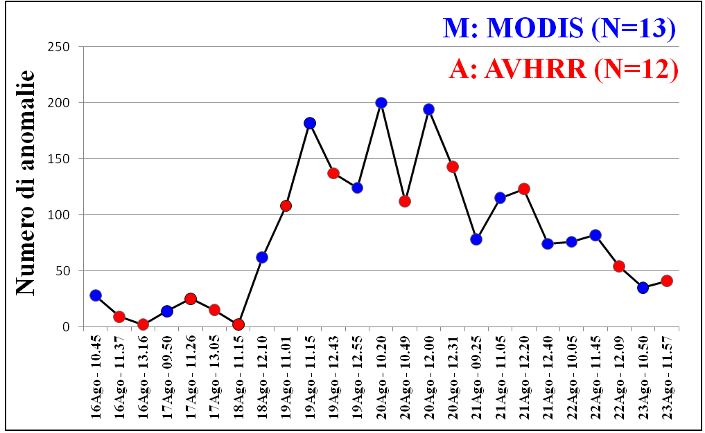
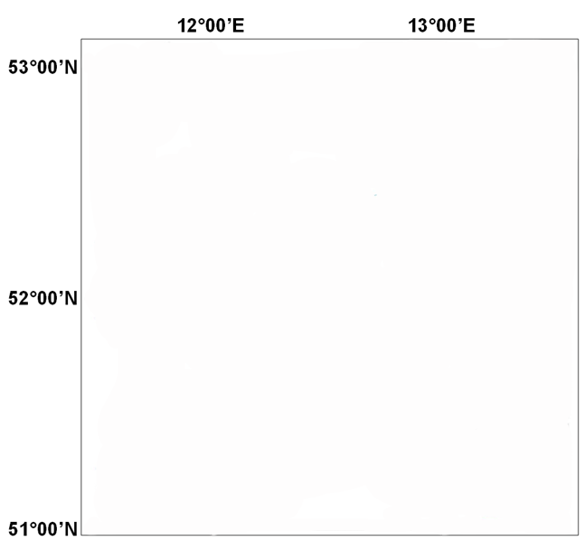
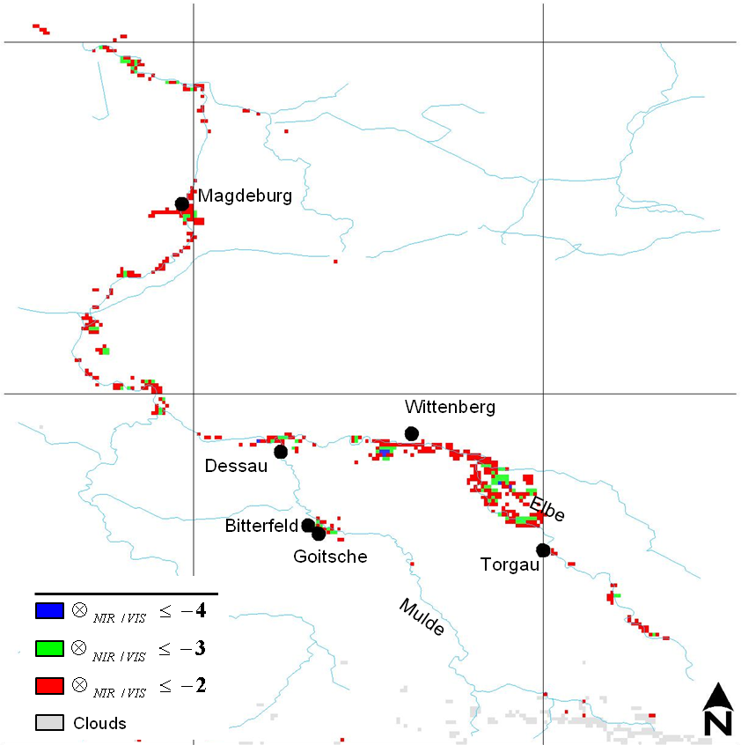
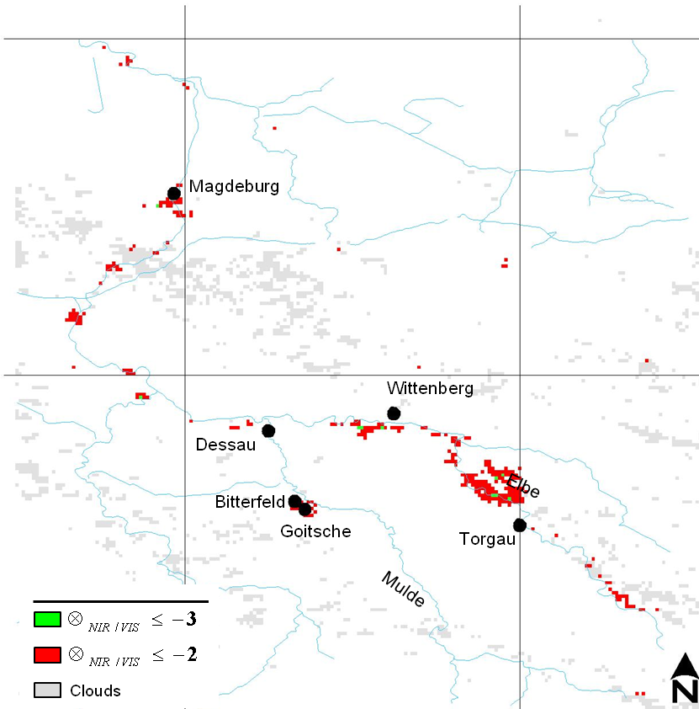
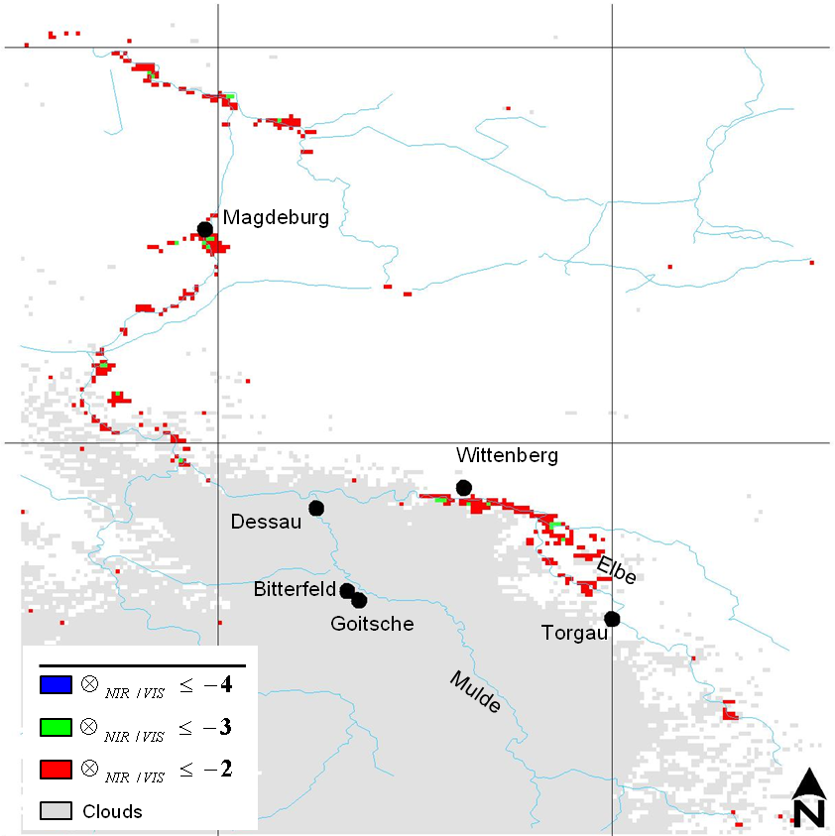
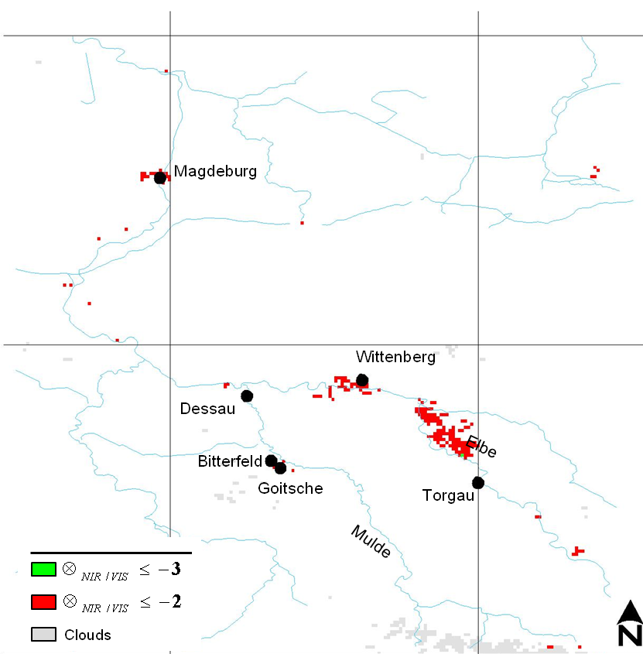
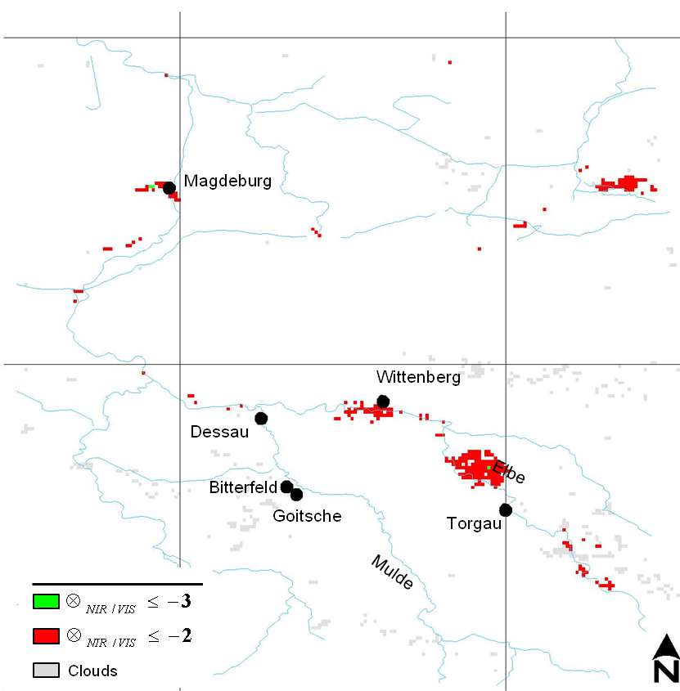
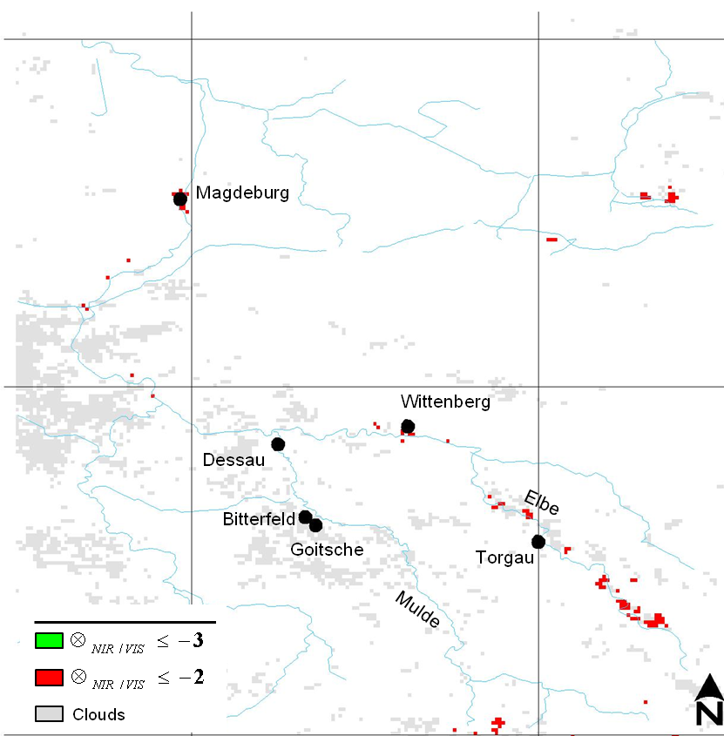
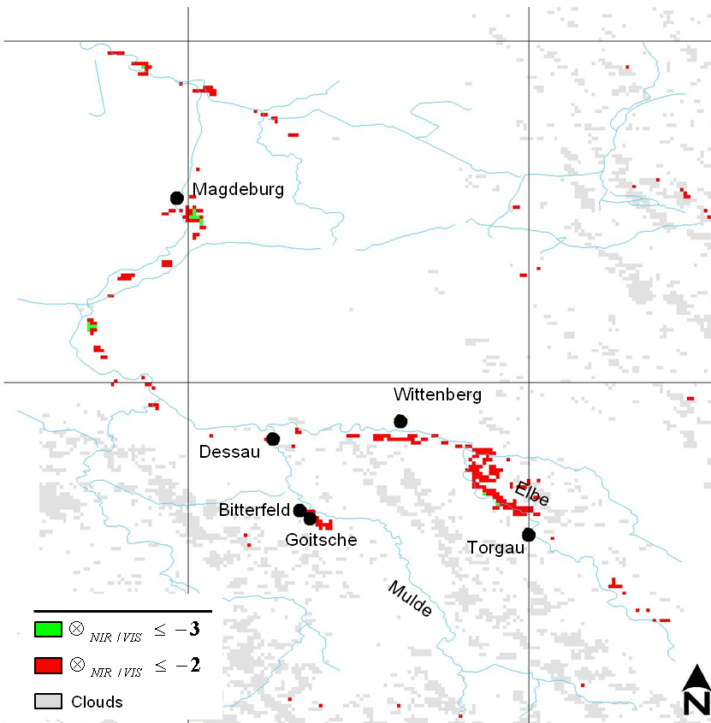
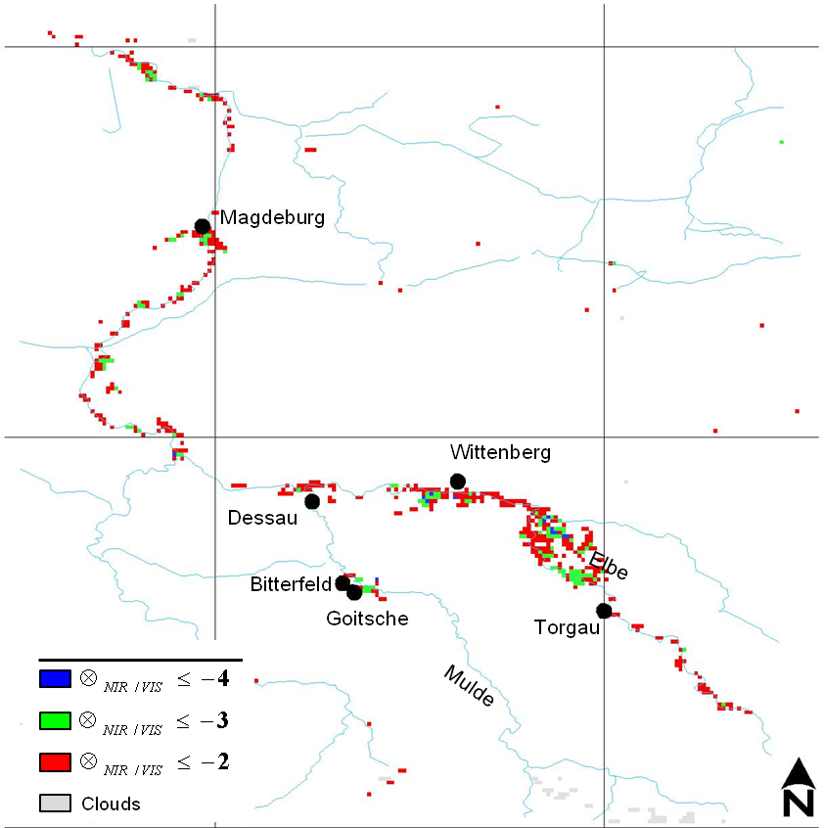
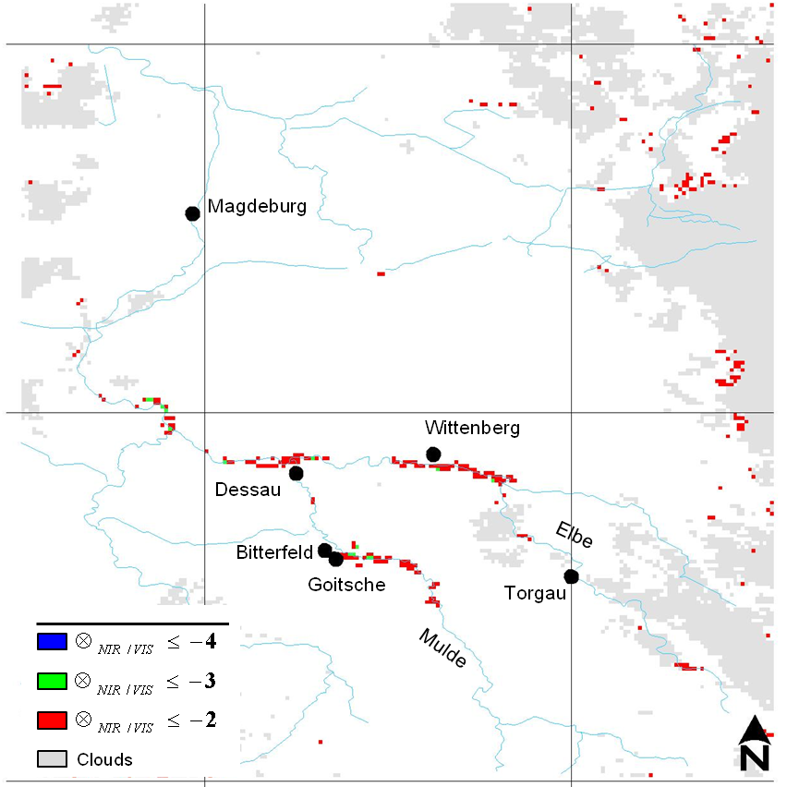
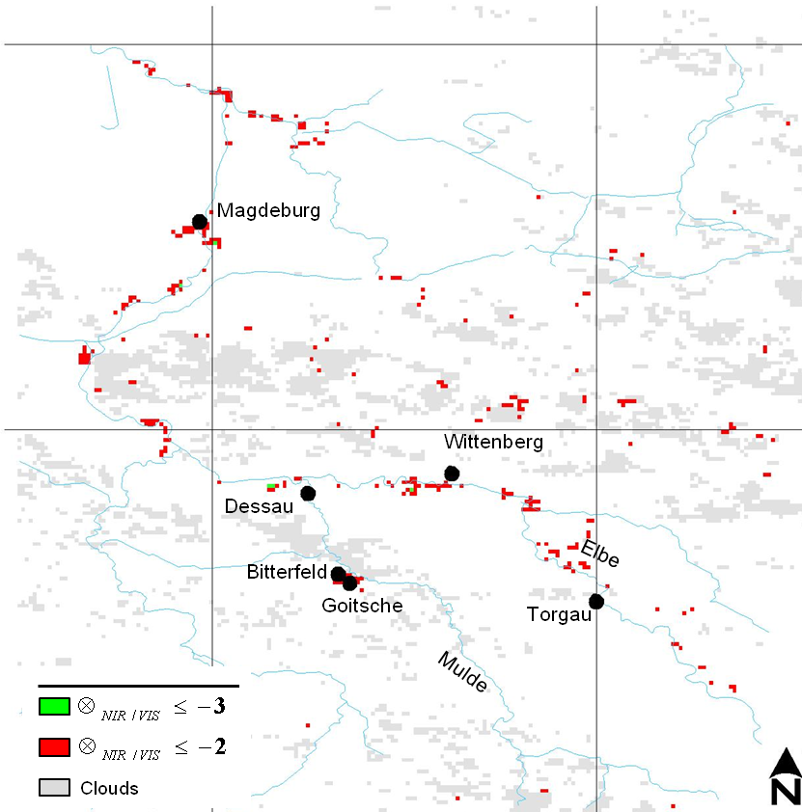
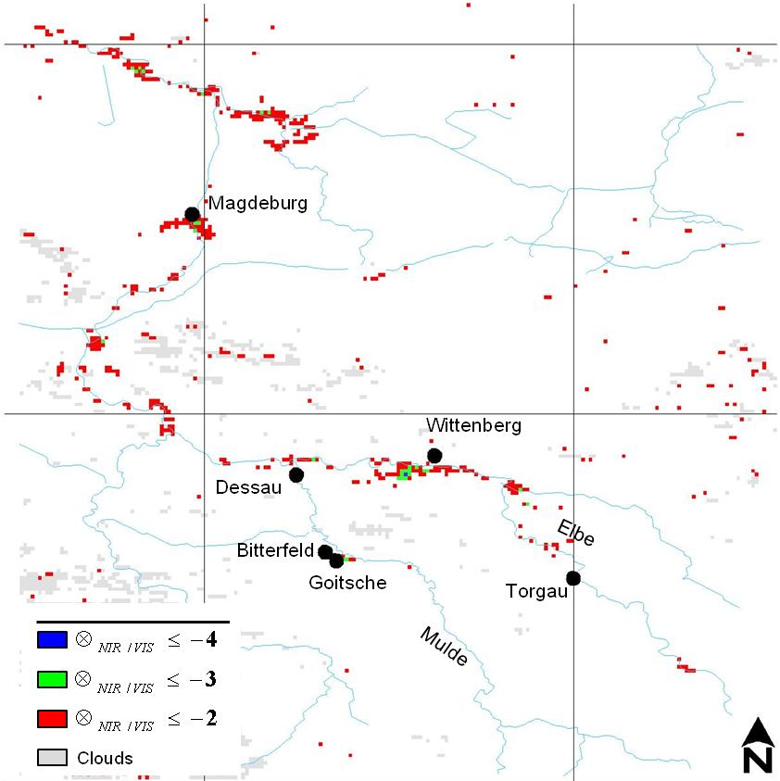
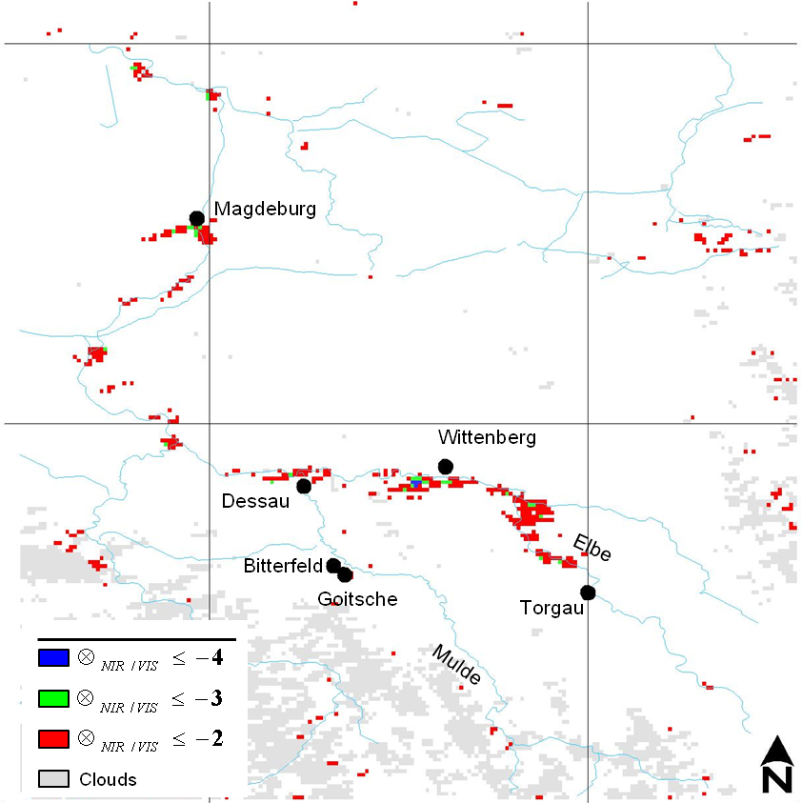
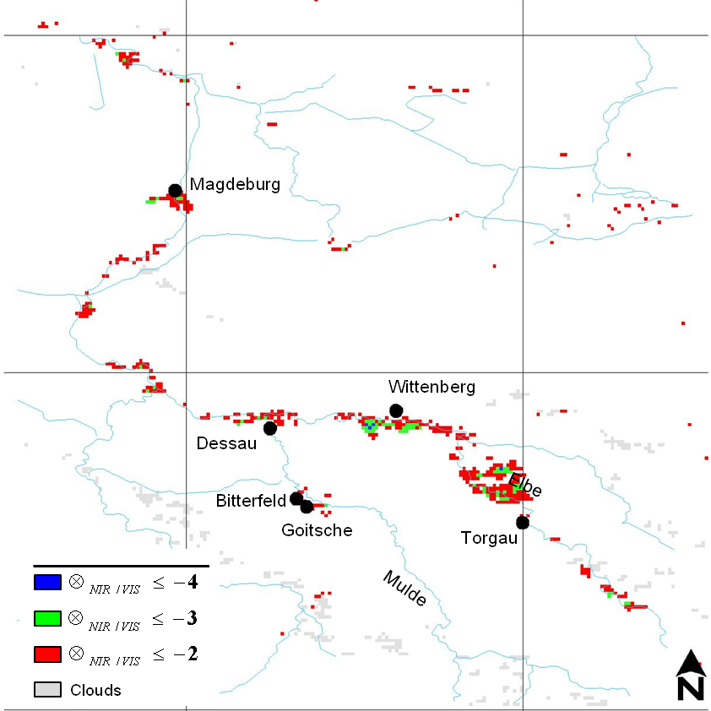
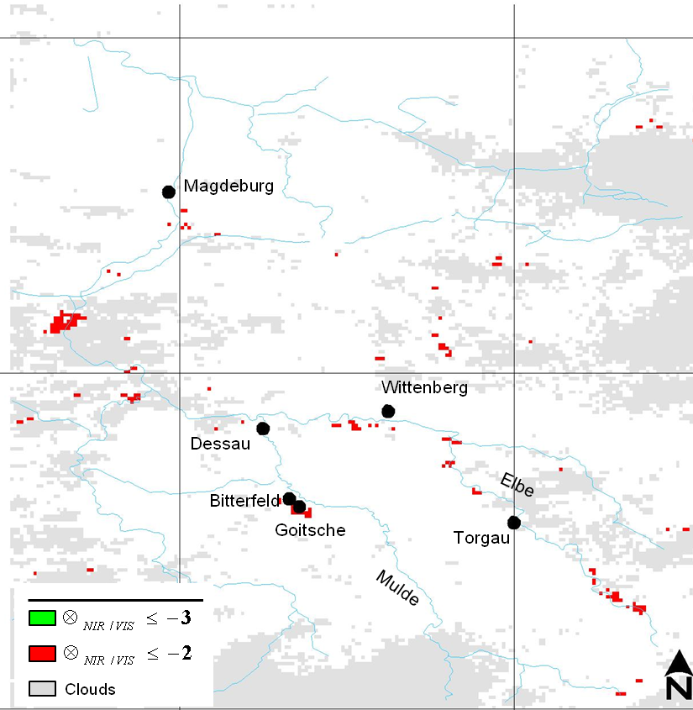











RST Application: Flood - Optical band
Optical band multi-sensor system
August 16,2002 – 10.45GMT
August 16,2002 – 11.37GMT
August 16,2002 – 13.16GMT
August 17,2002 – 09.50GMT
August 17,2002 – 11.26GMT
August 17,2002 – 13.05GMT
August 18,2002 – 11.15GMT
August 18,2002 – 12.10GMT
August 19,2002 – 11.01GMT
August 19,2002 – 11.15GMT
August 19,2002 – 12.43GMT
August 19,2002 – 12.55GMT
August 20,2002 – 10.20GMT
August 20,2002 – 10.49GMT
August 20,2002 – 12.00GMT
August 20,2002 – 12.31GMT
August 21,2002 – 09.25GMT
August 21,2002 – 11.05GMT
August 21,2002 – 12.20GMT
August 21,2002 – 12.40GMT
August 22,2002 – 10.05GMT
August 22,2002 – 11.45GMT
August 22,2002 – 12.09GMT
August 23,2002 – 10.50GMT
August 23,2002 – 11.57GMT
Anomalies number
Near real-time flood evolution monitoring
High surface-sampling temporal frequency, with higher opportunity to fill cloud cover gaps
CSPP 2019 – 25-27 June 2019, Shangri La Hotel Chengdu China Teodosio Lacava

Slide 13



RST Application: Flood - Optical band
Exploiting the other VIIRS Imagery bands possible combination
VIIRS on 4 December 2013 at 12:10 GMT
NDSI= (RED-SWIR)/(RED + SWIR)
CSPP 2019 – 25-27 June 2019, Shangri La Hotel Chengdu China Teodosio Lacava

Slide 14












RST Application: Flood - Optical band
Flood hazard map assessment
December 5, 2013 – 11.52 GMT
December 6, 2013 – 11.35 GMT
December 4, 2013 – 12.10 GMT
December 7, 2013 – 11.12 GMT
December 8, 2013 – 12.36 GMT
04/12/2013
12:10 GMT
05/12/2013
11:52 GMT
06/12/2013
11:35 GMT
07/12/2013
11:12 GMT
ALICE_{NDSI} ≥ 3
08/12/2013
12:36 GMT
Cloud Mask
Shadow Mask
VNG maps comparison
CSPP 2019 – 25-27 June 2019, Shangri La Hotel Chengdu China Teodosio Lacava

Slide 15


RST Application: Flood - Microwave
V(x,y,t) is the Brightness temperature difference between two AMSU window channels
(Soil Wetness Index = BT₈₉-BT₂₃) sensitive to water presence
CSPP 2019 – 25-27 June 2019, Shangri La Hotel Chengdu China Teodosio Lacava

Slide 16

















RST Application: Flood – Microwave and Optical
1-10
11-20
21-31
SWVI
AUGUST 2002
16/08/02 – 11.37GMT
16/08/02 – 13.16GMT
17/08/02 – 11.26GMT
17/08/02 – 13.05GMT
18/08/02 – 11.15GMT
19/08/02 – 11.01GMT
MODIS data
19/08/02 – 12.43GMT
20/08/02 – 10.49GMT
20/08/02 – 12.31GMT
21/08/02 – 12.20GMT
22/08/02 – 12.09GMT
23/08/02 – 11.57GMT
CSPP 2019 – 25-27 June 2019, Shangri La Hotel Chengdu China Teodosio Lacava

Slide 17



RST APPLICATIONS
Seawater quality monitoring
CSPP 2019 – 25-27 June 2019, Shangri La Hotel Chengdu China Teodosio Lacava

Slide 18




RST Application: Water Quality – Suspended Particulate Matter (SPM)
V(x,y,t) is the MODIS SPM Concentration (Nechad et al., 2010) derived by Rrs atmospherically corrected in the RED and NIR bands
CSPP 2019 – 25-27 June 2019, Shangri La Hotel Chengdu China Teodosio Lacava

Slide 19



RST Application: Water Quality – Clorophyll-a (chl-a)
V(x,y,t) is the MODIS/Aqua Level 3/Level 2 chl-a data
Level3 (4.6 km/8-day; 2003-2015)
Sub-tropical cycle for mid-latitude region
“non-blooming” trophic regime
          chl-a inter-annual (2003-2015) variability
Second half of January 2011 and the first half of February 2011
CSPP 2019 – 25-27 June 2019, Shangri La Hotel Chengdu China Teodosio Lacava

Slide 20







RST Application: Water Quality – Clorophyll-a (chl-a)
13 years (2003-2015) of MODIS L2 chl-a data (daily/1 km)
prevalently
cyclonic circulation regime
bloom effects decrease from the second decade of February 2011
The bloom was caused by inflow of the cold, rich in nutrient, Adriatic Dense Water from the Strait of Otranto into the Gulf of Taranto
CSPP 2019 – 25-27 June 2019, Shangri La Hotel Chengdu China Teodosio Lacava

Slide 21




RST Application: Oil Spill detection and monitoring
V(x,y,t) is the signal acquired in the TIR bands of MODIS/AVHRR or in their VNIR bands (RST-OIL)
DEEPWATER HORIZON
GULF OF MEXICO – 20 April 2010
Deepwater Horizon Location
Missisipi River Delta
Deepwater Horizon Platform
Land
MODIS TIR
RST oil spill maps
Clouds
Oil
MODIS RGB VISIBLE
25.04.2010 1855 GMT
CSPP 2019 – 25-27 June 2019, Shangri La Hotel Chengdu China Teodosio Lacava

Slide 22



RST Application: Oil Spill detection and monitoring
V(x,y,t) is the signal acquired in the TIR bands of MODIS/AVHRR or in their VNIR bands (RST-OIL)
25.04.2010 18.55 Aqua
29.04.2010 16.55 Terra
89.5° W
89.5° W
29.8° N
29.8° N
Land/Clouds
RST-OIL TIR
RST-OIL VNIR
0
50 km
0
50 km
27.7° N
27.7° N
87.18 ° W
87.18 ° W
CSPP 2019 – 25-27 June 2019, Shangri La Hotel Chengdu China Teodosio Lacava

Slide 23

RST APPLICATIONS
Volcanic risk
CSPP 2019 – 25-27 June 2019, Shangri La Hotel Chengdu China Teodosio Lacava

Slide 24


RST Application: Ash Plume Detection and Tracking
V(x,y,t) is a combination of the signal acquired in Thermal/Middle infrared Bands of AVHHR or MODIS or SEVIRI (RST-ASH)
Etna Eruption, November-Dicember 2002 - AVHRR
Eyjafjallajökull (Iceland)
April - May 2010
8 May 2010 (00:00 to 01:45 GMT) SEVIRI data
Support to Italian Department of Civil Protection for ash plume NRT monitoring
CSPP 2019 – 25-27 June 2019, Shangri La Hotel Chengdu China Teodosio Lacava

Slide 25

RST Application: Hotspot Detection
V(x,y,t) is a combination of the signal acquired in Middle/Thermal infrared Bands of AVHHR or MODIS or SEVIRI (RST-VOLC)
CSPP 2019 – 25-27 June 2019, Shangri La Hotel Chengdu China Teodosio Lacava

Slide 26



RST Application: Hotspot Detection
V(x,y,t) is a combination of the signal acquired in Middle/Thermal infrared Bands of AVHHR or MODIS or SEVIRI (RST-VOLC)
The Mt Asama eruption of September 2004
AVHRR data
The December 2002 Mt Etna and Stromboli eruptive events
28 December 2002 MODIS data
CSPP 2019 – 25-27 June 2019, Shangri La Hotel Chengdu China Teodosio Lacava

Slide 27



RST APPLICATIONS
Forest fires detection and NRT monitoring
CSPP 2019 – 25-27 June 2019, Shangri La Hotel Chengdu China Teodosio Lacava

Slide 28









RST Application: Fire Detection
Development of ICT products for Civil Protection authorities
RST-based thermal anomalies
2010-08-07 08:00 GMT
RST-based thermal anomalies
2010-08-07 08:15 GMT
RST-based thermal anomalies
2010-08-07 08:30 GMT
RST-based thermal anomalies
2010-08-07 08:45 GMT
RST-based thermal anomalies
2010-08-07 09:00 GMT
RST-based thermal anomalies
2010-08-07 09:15 GMT
RST-based thermal anomalies
2010-08-07 09:30 GMT
RST-based thermal anomalies
2010-08-07 09:45 GMT
RST-based thermal anomalies
2010-08-07 10:00 GMT
RST-based thermal anomalies
2010-08-07 10:15 GMT
RST-based thermal anomalies
2010-08-07 10:30 GMT
RST-based thermal anomalies
2010-08-07 10:45 GMT
RST-based thermal anomalies
2010-08-07 11:00 GMT
RST-based thermal anomalies
2010-08-07 11:15 GMT
RST-based thermal anomalies
2010-08-07 11:30 GMT
RST-based thermal anomalies
2010-08-07 11:45 GMT
RST-based thermal anomalies
2010-08-07 12:00 GMT
RST-based thermal anomalies
2010-08-07 12:15 GMT
RST-based thermal anomalies
2010-08-07 12:30 GMT
RST-based thermal anomalies
2010-08-07 12:45 GMT
RST-based thermal anomalies
2010-08-07 13:00 GMT
RST-based thermal anomalies
2010-08-07 13:15 GMT
RST-based thermal anomalies
2010-08-07 13:30 GMT
RST-based thermal anomalies
2010-08-07 13:45 GMT
RST-based thermal anomalies
2010-08-07 14:00 GMT
RST-based thermal anomalies
2010-08-07 14:15 GMT
RST-based thermal anomalies
2010-08-07 14:30 GMT
RST-based thermal anomalies
2010-08-07 14:45 GMT
RST-based thermal anomalies tool to support in real time local authorities during fire monitoring campaigns in Sicily
RST-based thermal anomalies
2010-08-07 15:00 GMT
Palermo Regional
Province
CSPP 2019 – 25-27 June 2019, Shangri La Hotel Chengdu China Teodosio Lacava

Slide 29










RST Application: Fire Detection
Development of ICT products for Civil Protection authorities
A RST-based web -application for the National Civil Protection Department supporting forest fires detection and monitoring
08:00GMT
08:15GMT
08:30GMT
08:45GMT
09:00GMT
09:15GMT
09:30GMT
09:45GMT
CSPP 2019 – 25-27 June 2019, Shangri La Hotel Chengdu China Teodosio Lacava

Slide 30


RST Application: Fire Detection
Development of ICT products for Civil Protection authorities
23 July 2009, Contemporary and concurrent requests to DPC for aerial resources
PRIORITY
Regalbuto (Enna – Sicily)
Pau (Oristano – Sardegna)
CSPP 2019 – 25-27 June 2019, Shangri La Hotel Chengdu China Teodosio Lacava

Slide 31






RST Application: Gas Flaring - Infrared
Geostationary sensors (i.e., MSG-SEVIRI)
NRT Gas Flaring monitoring
V(x,y,t) is the Brightness Temperature in the MIR (~4μm) band (ch04: 3.48-4.36 μm)
Oil&Gas Plant (COVA, Southern Italy) accidental event
Web application for a real-time monitoring
of MSG/SEVIRI radiances
13 January 2014 - 11.26 LT
13 November 2015 – 9.45 LT
CSPP 2019 – 25-27 June 2019, Shangri La Hotel Chengdu China Teodosio Lacava

Slide 32




RST Application: Gas Flaring - Infrared
Polar sensors (i.e., EOS-MODIS)
V(x,y,t) is the Brightness Temperature difference
between MIR and TIR bands
RST-FLARE
ch20: 3.66÷3.84 μm
ch31: 10.78÷11.28 μm
Niger Delta Region Gas Flaring Status in 2000÷2016
Detection of sites affected by gas flares + temporal evolution
Computation of gas annually flared
+ temporal variation
Spatial distribution of flaring sites detected by RST-FLARE in 2000-2016
Annual values of gas flared volumes
Temporal variation in the number of annually detected flaring sites
CSPP 2019 – 25-27 June 2019, Shangri La Hotel Chengdu China Teodosio Lacava

Slide 33



RST APPLICATIONS
Seismic Risk
CSPP 2019 – 25-27 June 2019, Shangri La Hotel Chengdu China Teodosio Lacava

Slide 34










RST Application: Seismic Risk (Thermal Anomalies detection)
RST analysis over Italy at the time of Abruzzo Earthquakes (6 April 2009)
SEVIRI
SEVIRI
SEVIRI
30 March 2009
00:00 GMT
31 March 2009
00:00 GMT
01 April 2009
00:00 GMT
MODIS
MODIS
MODIS
30 March 2009
31 March 2009
01
April
2009
01:10:00 GTM
01:14:56 GTM
00:57:47 GTM
AVHRR
AVHRR
AVHRR
RETIRA ≥ 2
RETIRA ≥ 2,5
RETIRA ≥ 3
RETIRA ≥ 3,5
RETIRA ≥ 4
clouds
no data
Tectonic
lineaments
30 March 2009
31 March 2009
01 April 2009
00:22:57 GMT
01:57:31 GMT
01:46:49 GMT
CSPP 2019 – 25-27 June 2019, Shangri La Hotel Chengdu China Teodosio Lacava

Slide 35





























RST Application: Seismic Risk (Thermal Anomalies detection)
CONFUTATION (March 15th – April 15th 2008, MSG-SEVIRI 00:00 GMT)
19 March 2008
16 March 2008
19 March 2008
15 March 2008
16 March 2008
15 March 2008
18 March 2008
17 March 2008
18 March 2008
17 March 2008
Seismic events (Ml>4) occurred during
March
March
-
-
April 2008 (INGV, 2009)
April 2008 (INGV, 2009)
24 March 2008
20 March 2008
24 March 2008
20 March 2008
21 March 2008
21 March 2008
22 March 2008
22 March 2008
23 March 2008
23 March 2008
16 March 2008
17 March 2008
29 March 2008
26 March 2008
29 March 2008
26 March 2008
28 March 2008
27 March 2008
28 March 2008
27 March 2008
31 March 2008
25 March 2008
31 March 2008
25 March 2008
30 March 2008
30 March 2008
1
19 March 2008
1
April
April
2008
2008
7
7
April
April
2008
4
2008
4
April
April
2008
2008
5
5
April
April
2008
3
2008
3
April
April
2008
2
2008
2
April
April
2008
2008
18 March 2008
6
6
April
April
2008
2008
RETIRA ≥ 4
clouds
no data
CSPP 2019 – 25-27 June 2019, Shangri La Hotel Chengdu China Teodosio Lacava

Slide 36
Conclusion
The availability of long-term historical series of satellite data has fostered the implementation of the RST approach, that has been applied with satisfactory results to analyze several natural/environmental/man-made hazards
Other applications deal with: Desertification process monitoring, Sand storm detection, Radio Frequency Interference Sources Detection, Pipeline Blasts detection, Bonfires in refugee camps…
The only mandatory requirement for a full implementation of RST is the availability of historical series long enough to produce consistent and reliable reference fields.
CSPP 2019 – 25-27 June 2019, Shangri La Hotel Chengdu China Teodosio Lacava

Slide 37










Conclusion
The availability of the direct readout satellite receiving station plus efficient and always updated processing softwares allowed us the development of automatic processing chains for real time detection and monitoring of these kind of hazards
OUTPUTS
Pre-processing (calibration, navigation,…)
Real time RST-based processing
High intensity hotspots
Low intensity hotspots
CSPP 2019 – 25-27 June 2019, Shangri La Hotel Chengdu China Teodosio Lacava

Slide 38
THANKS FOR YOUR ATTENTION
teodosio.lacava@imaa.cnr.it

